Slide 1
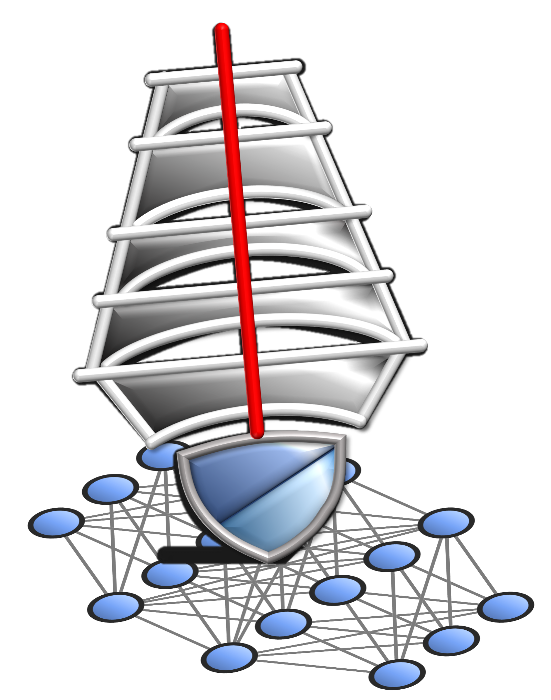
DeepMainMast Tutorial
Protein Structure Modeling: DeepMainmast on Web server
https://em.kiharalab.org/algorithm/DeepMainMast
DeepMainmast on Google Colab
Google Colab is a free cloud service from Google that provides an environment similar to Jupyter Notebooks.
https://github.com/kiharalab/DeepMainMast

Slide 2
DeepMainmast on EM Server, Google Colab, or Source Code
 | Installing | Confidential? | Hardware | Computational Time Limits | Full-Atom Modeling & Refinement | Parameters
Web Server | n/a | No | 8 CPU cores GPU (24GB) | unlimited | Available (Rosetta) | ~4 full-atom Models
Google Colab | Automated in notebook | Yes | 2 CPU cores GPU (15GB) | ~4 hours (free) | Only Cα modeling | ~4 Cα Models
Install code from GitHub | Python-conda environment | Yes | 8~ CPU cores GPU (> 10GB) | unlimited | Available (Rosetta) | Full control ~20 full-atom Models
Terashi, Genki, et al. "Integrated Protocol of Protein Structure Modeling for Cryo-EM with Deep Learning and Structure Prediction." bioRxiv (2023)
Notes:
Server Admin can see your input.
What is the Google colab. We do not see your submission.
Good thing, user can share.

Slide 3
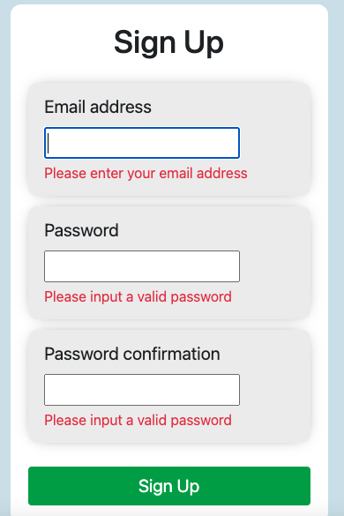
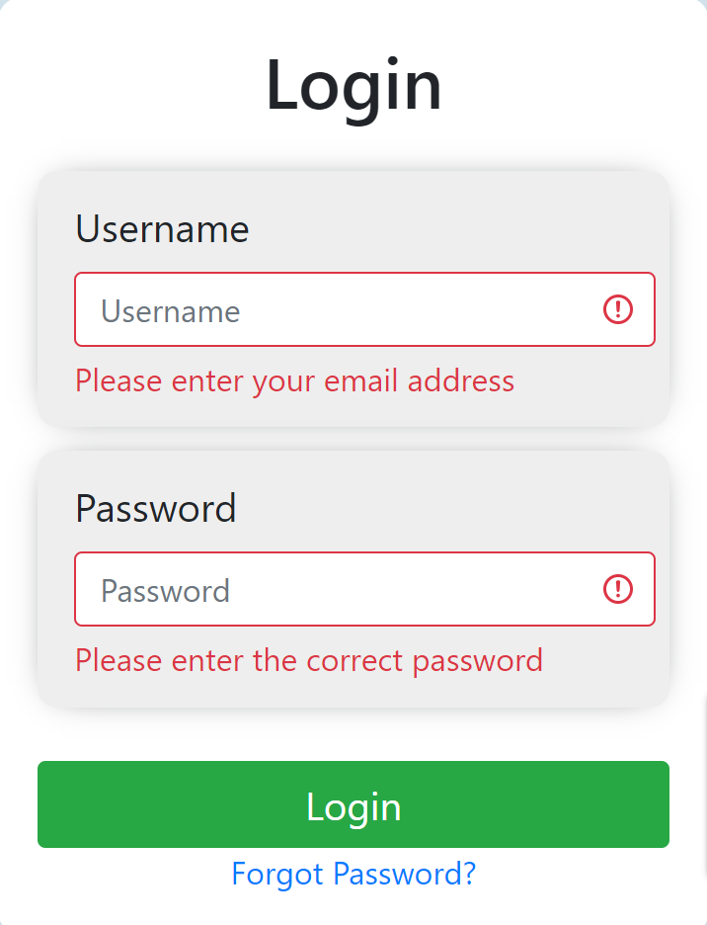
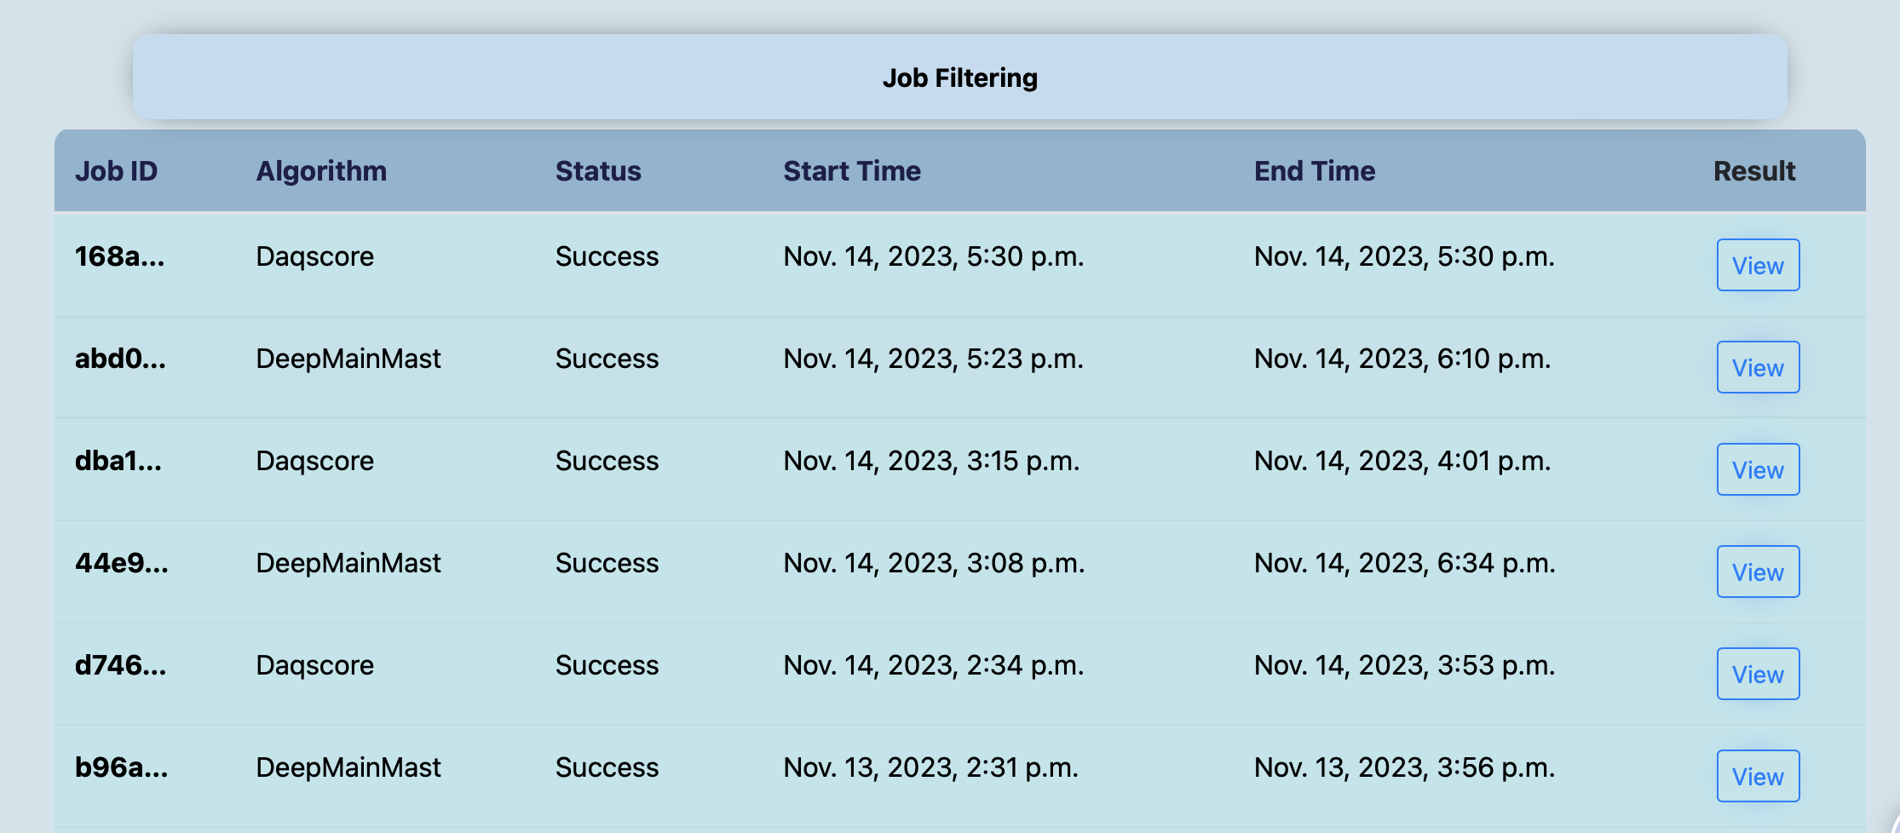
(optional) Registration in Web server https://em.kiharalab.org
https://em.kiharalab.org/users/registerpage
You will need to verify your email address to activate the account. The email will usually arrive instantly, but it might also take up to 1-2 hours.
Job History

Slide 4
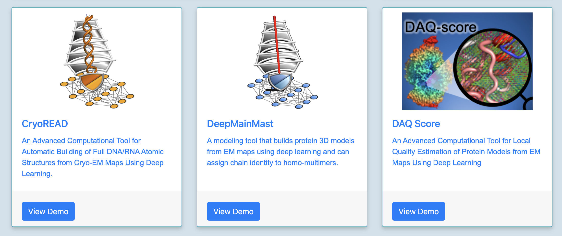
DeepMainmast in Web Server https://em.kiharalab.org
FAST 24GB GPU card
8-core CPU
No CPU time limitation
Full-atom building & refinement
https://em.kiharalab.org/algorithm/DeepMainMast
Example:
https://em.kiharalab.org/job/viewjob/09f2a6b6a14ad5f210c33abb1c70511c
https://em.kiharalab.org/job/viewjob/1605134d4bdc9c1fcc51e7df4bdda310

Slide 5
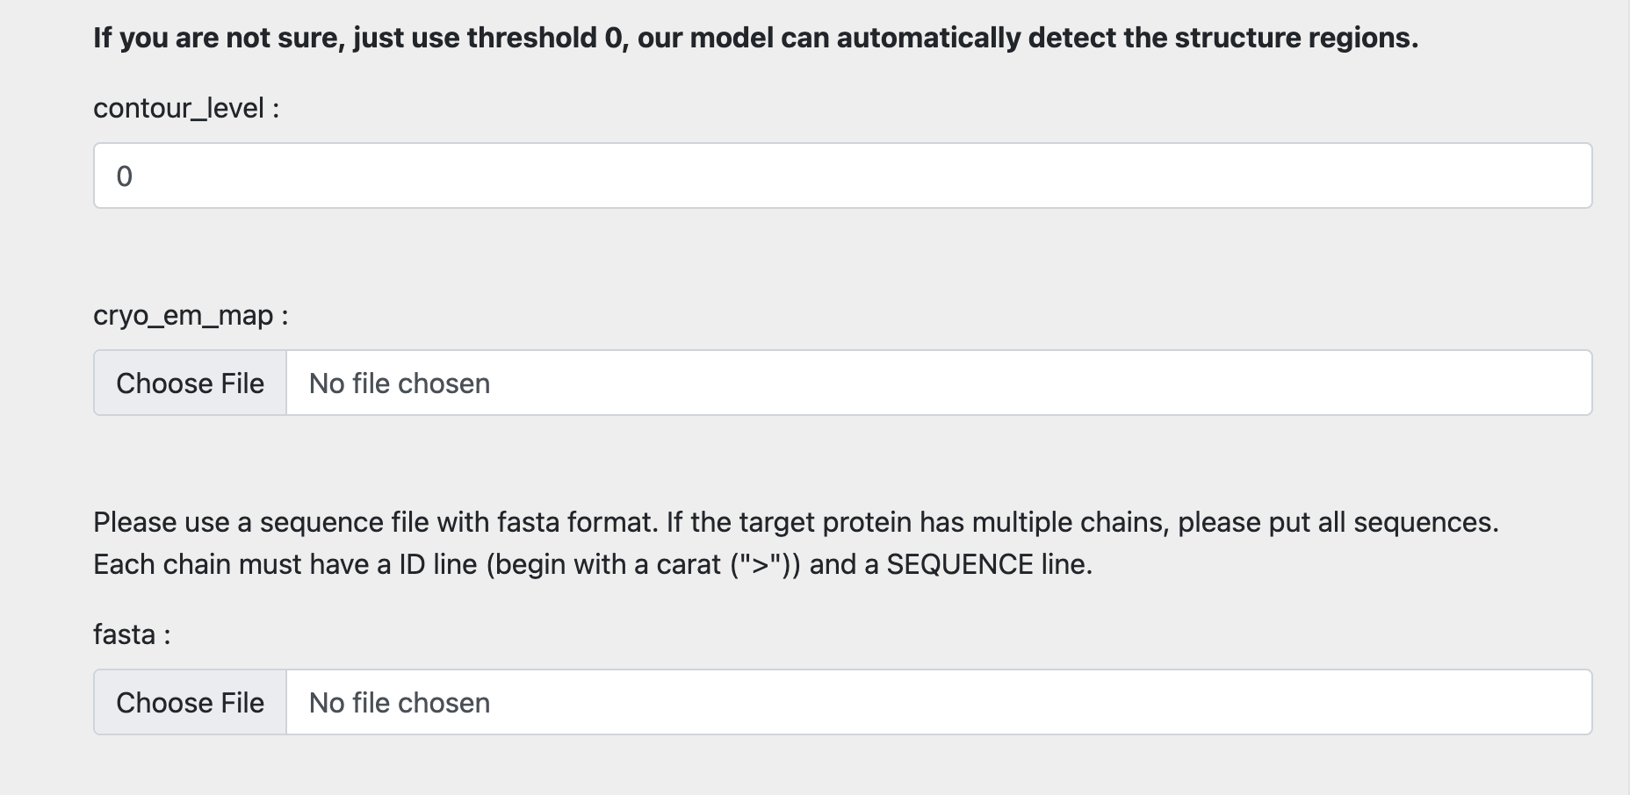
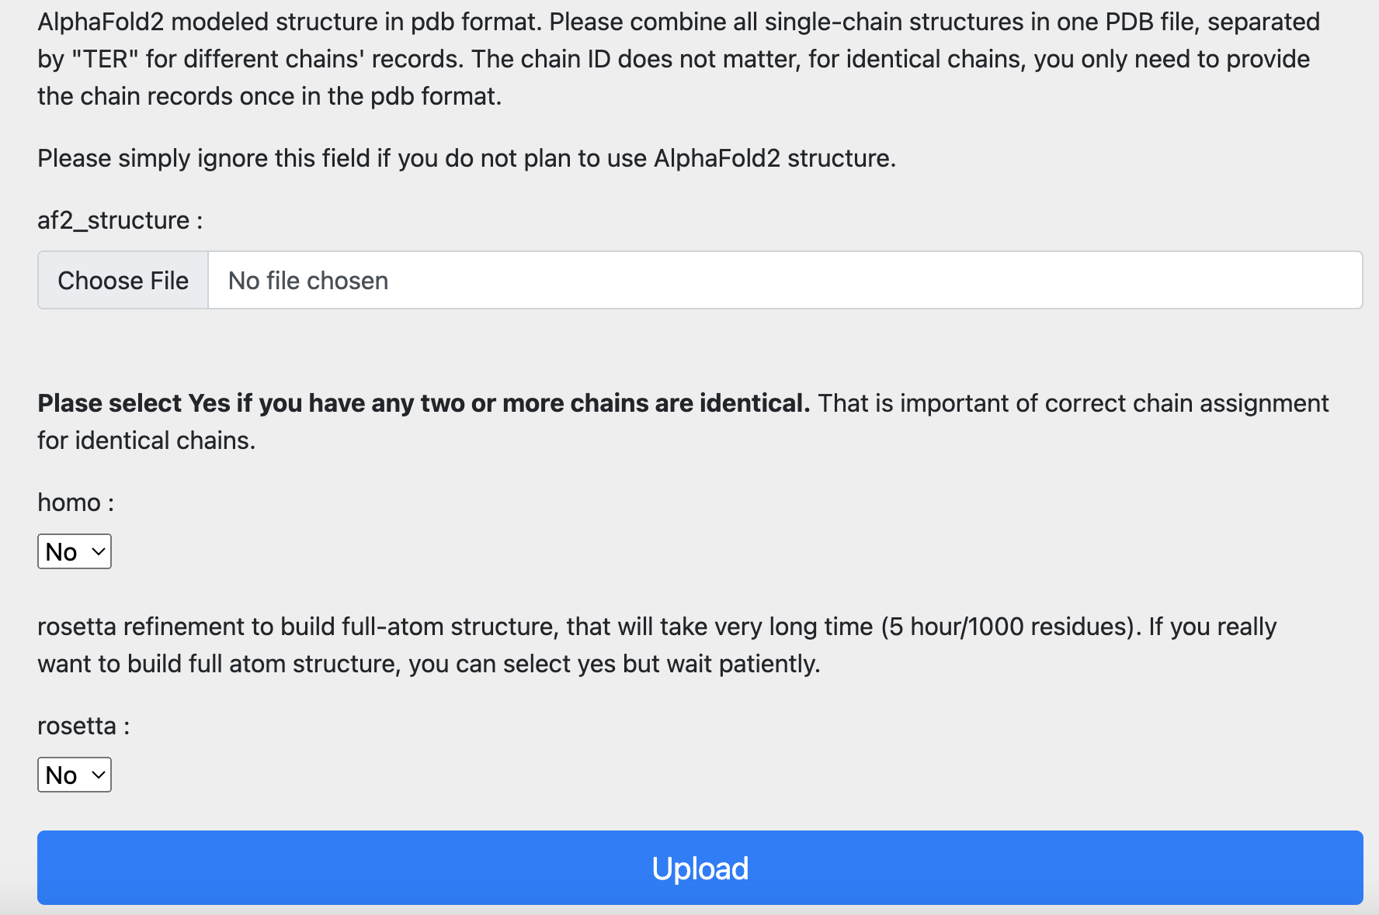
DeepMainmast in Web Server
Contour Level (reduce CPU time)
AF2 models
(optional)
EM map
Chain ID assignment for Homo-oligomer
Full-Atom model building & Refinement by Rosetta (optional)
Sequence File (FASTA format)
>2513A
SERIVISPTSRQEGHAELVMEVDDEGIVTKGRYFSITPVRGLEKMVTGKAPETAPVMVQRICGVCPIPHTLASVEA
>2513B
KPRIGYIHLSGCTGDAMSLTENYDILAELLTNMVDIVYGQTLVDLWEMPEMDLALVEGSVCLQDEHSLHELKELREKAKLVCAG
>2513C
VLGTYKEIVSARSTDREIQKLAQDGGIVTGLLAYALDEGIIEGAVVAGPGEEFWKPQPMVAMSSDELKAAAGTKYTEKLGTVAIPCQTMGIRKMQTYPFGVRFLADKIKLLVGIYCMENFPYTSLQTFI

Slide 6
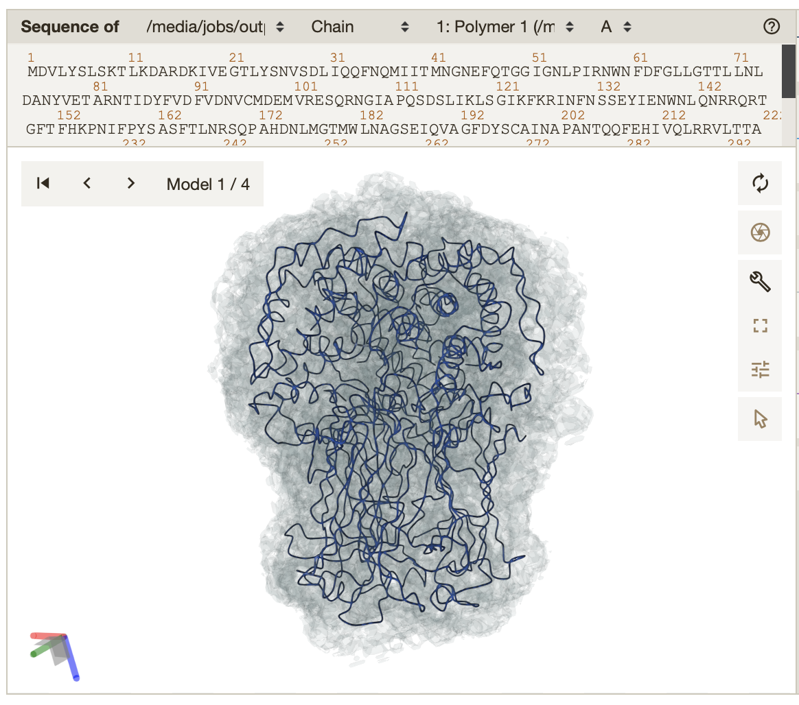
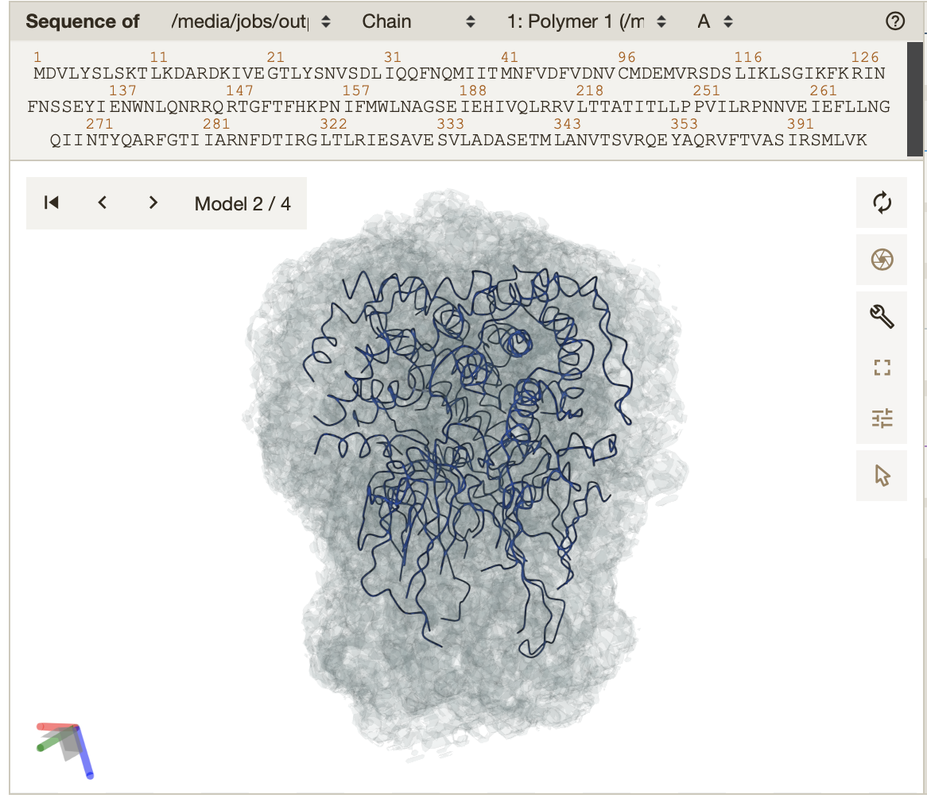
EMD-1461 (res. 3.8Å) https://em.kiharalab.org/job/viewjob/a6d42fccb442da6861365e6d1dd81926
Model1: C-alpha Model
Model2: C-alpha Model only confident regions

Slide 7
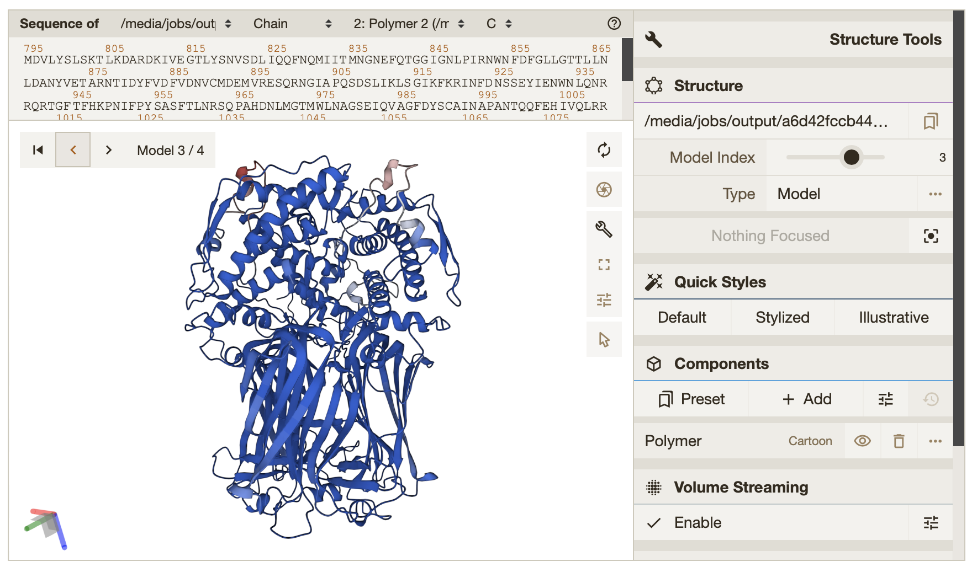
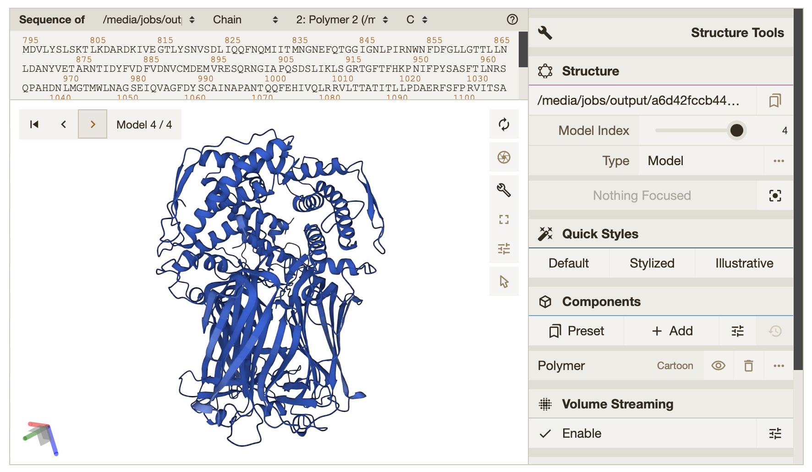
EMD-1461 (res. 3.8Å) https://em.kiharalab.org/job/viewjob/a6d42fccb442da6861365e6d1dd81926
●Low confidence region
●High confidence region
Model3: Full-Atom Model
Model4: Full-Atom Model only confident regions

Slide 8
DeepMainmast Google Colab version
https://github.com/kiharalab/DeepMainMast
Free and confidential. 4-hour limitation. 2CPU cores. 15GB GPU.
Can not use full-atom model building and refinement.
Limited number of parameter combinations

Slide 9
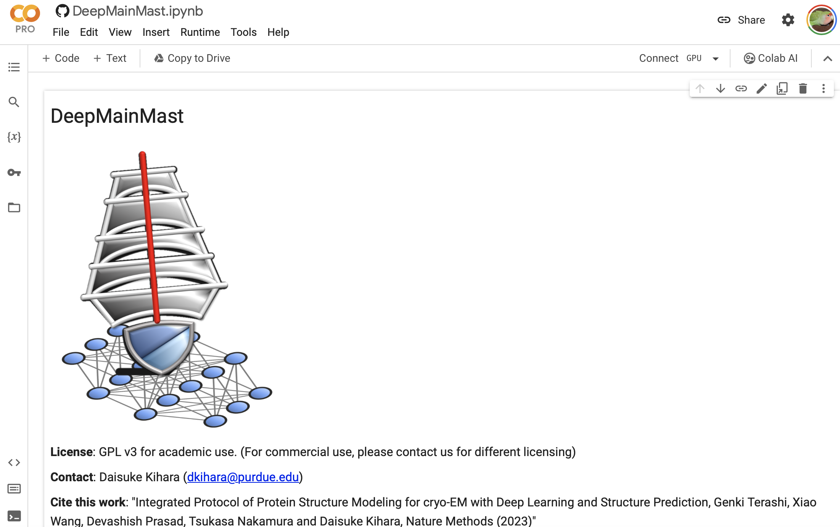
Click [Connect GPU]

Slide 10
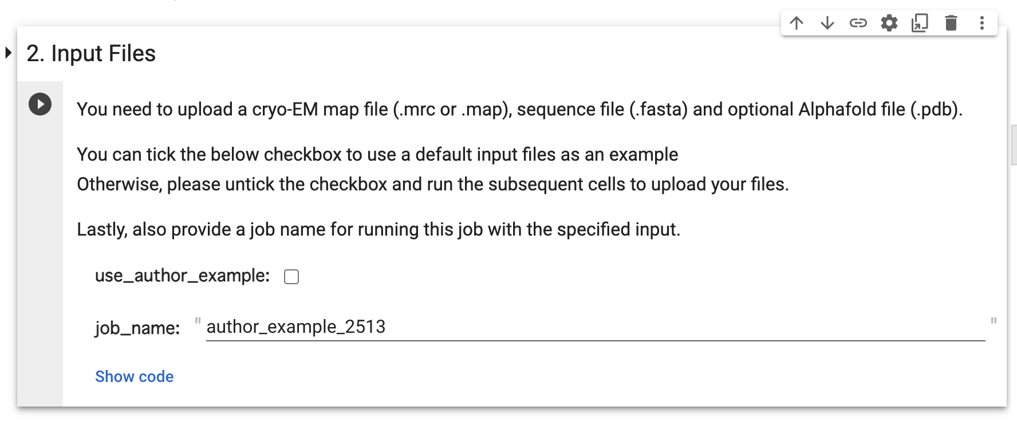
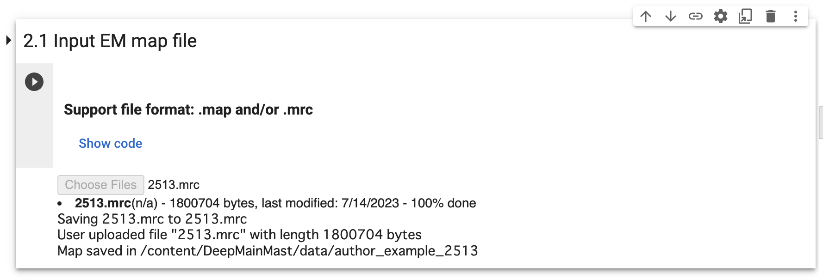
Set Job name and input a map file

Slide 11
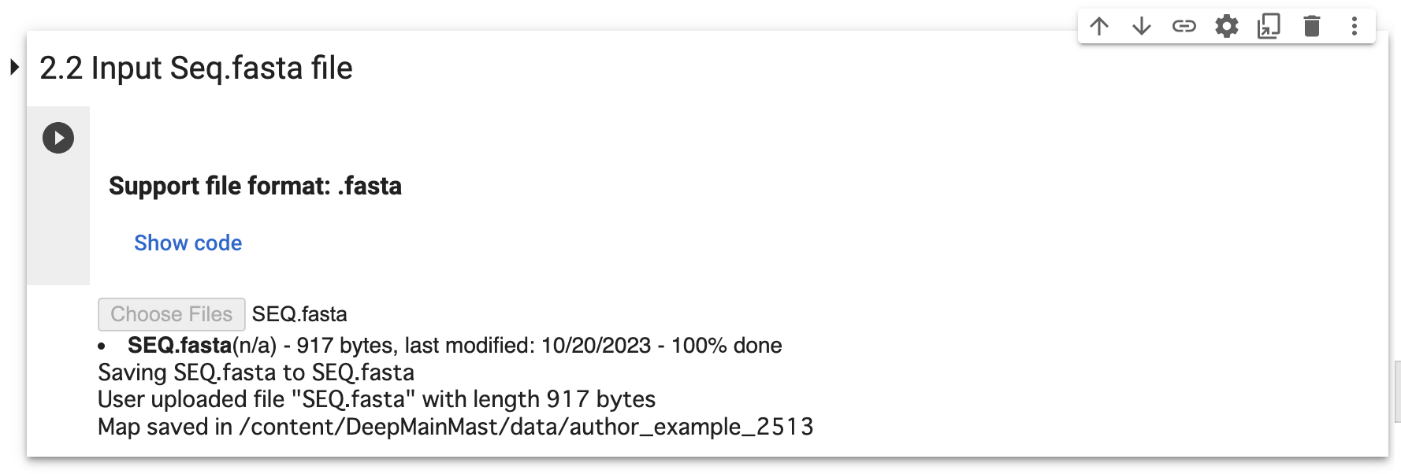
Upload a sequence file
>2513A
SERIVISPTSRQEGHAELVMEVDDEGIVTKGRYFSITPVRGLEKMVTGKAPETAPVMVQRICGVCPIPHTLASVEAIDDSLDIEVPKAGRLLRELTLAAHHVNSHAIHHFLIAPDFVPENLMADAINSVS
>2513B
KPRIGYIHLSGCTGDAMSLTENYDILAELLTNMVDIVYGQTLVDLWEMPEMDLALVEGSVCLQDEHSLHELKELREKAKLVCAFGSCAATGCFTRYSRGG
>2513C
VLGTYKEIVSARSTDREIQKLAQDGGIVTGLLAYALDEGIIEGAVVAGPGEEFWKPQPMVAMSSDELKAAAGTKYTFSPNVMMLKKAVRQYGIEKLGTVAIPCQTMGIRKMQTYPFGVRFLADKIKLLVGIYCMENFPYTSLQTFI

Slide 12
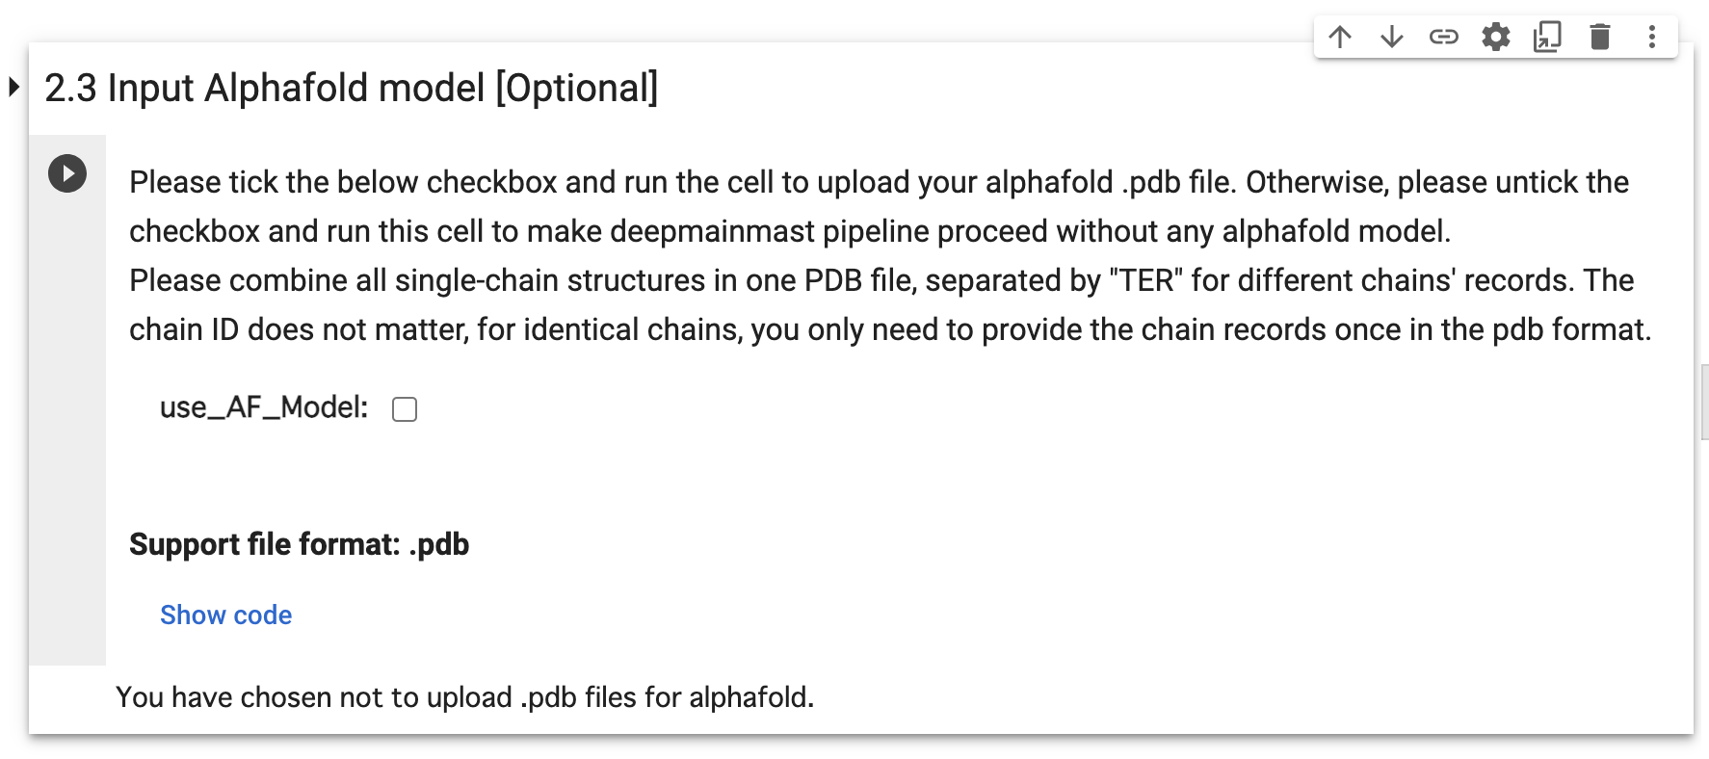
Optional: Upload AF2 models

Slide 13
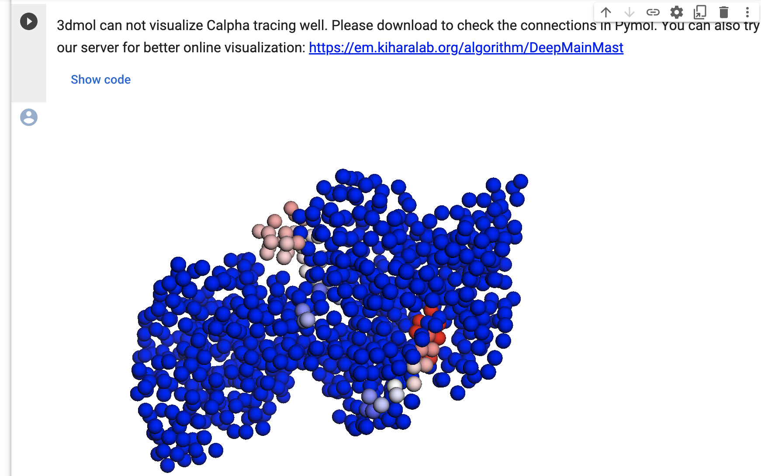
Cα Model in 3D viewer
●Low confidence region
●High confidence region

Slide 14
DeepMainmast: Command Line
https://github.com/kiharalab/DeepMainMast
Full control of the DeepMainmast pipeline.
Rosetta can generate multiple full-atom models.
Detail Instructions:
https://github.com/kiharalab/DeepMainMast

