Slide 1
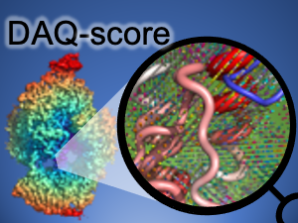
DAQ Tutorial
Model Assessment: DAQ score on Web server
https://em.kiharalab.org/algorithm/daqscore
DAQ score on Google Colab
https://github.com/kiharalab/DAQ

Slide 2
DAQ score on EM Server, Google Colab, or Source Code
 | Installing | Confidential? | Hardware | Computational Time Limits | Visualization
Web Server | n/a | No | 8 CPU cores GPU (24GB) | unlimited | 3D model 2D graph
Google Colab | Automated in notebook | Yes | 2 CPU cores GPU (15GB) | ~4 hours (free) | 3D model 2D graph
Install code from GitHub | Python-conda environment | Yes | 8~ CPU cores GPU (> 10GB) | unlimited | n/a
Terashi, Genki, et al. "Residue-wise local quality estimation for protein models from cryo-EM maps." Nature Methods 19.9 (2022): 1116-1125.

Slide 3
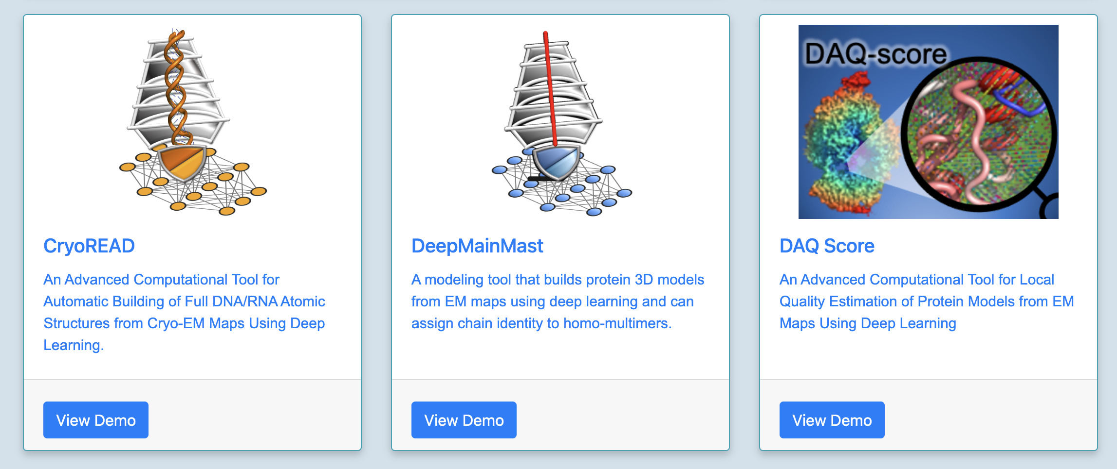
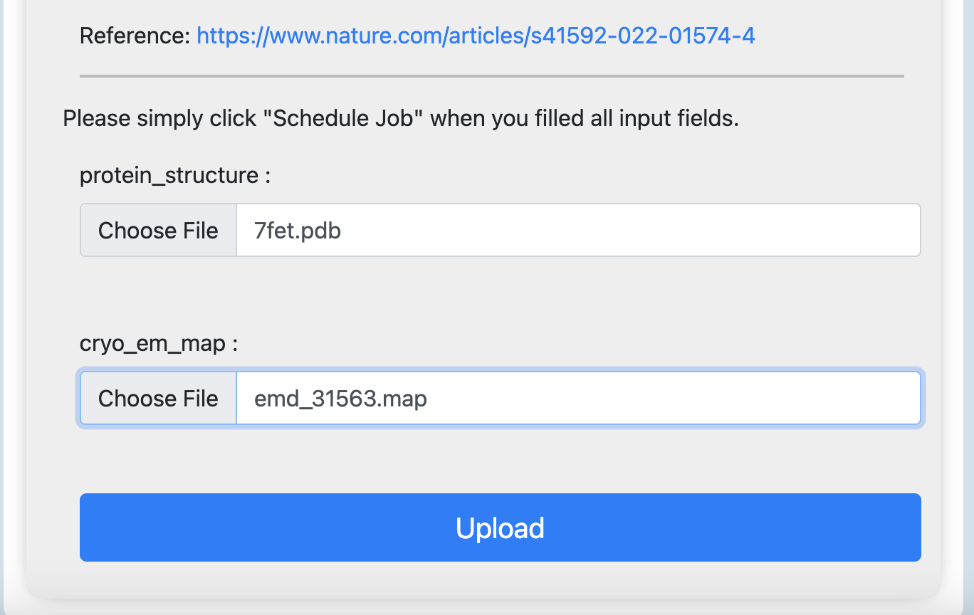
DAQ score on Web server
https://em.kiharalab.org/
Input Example:
MAP file: EMD-31563
https://www.emdataresource.org/EMD-31563
PDB model: 7FET
https://www.rcsb.org/structure/7FET
Result:
https://em.kiharalab.org/job/viewjob/8167be2225a124319cd9a833ba898544

Slide 4
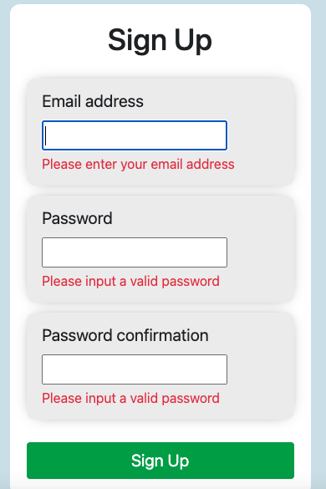
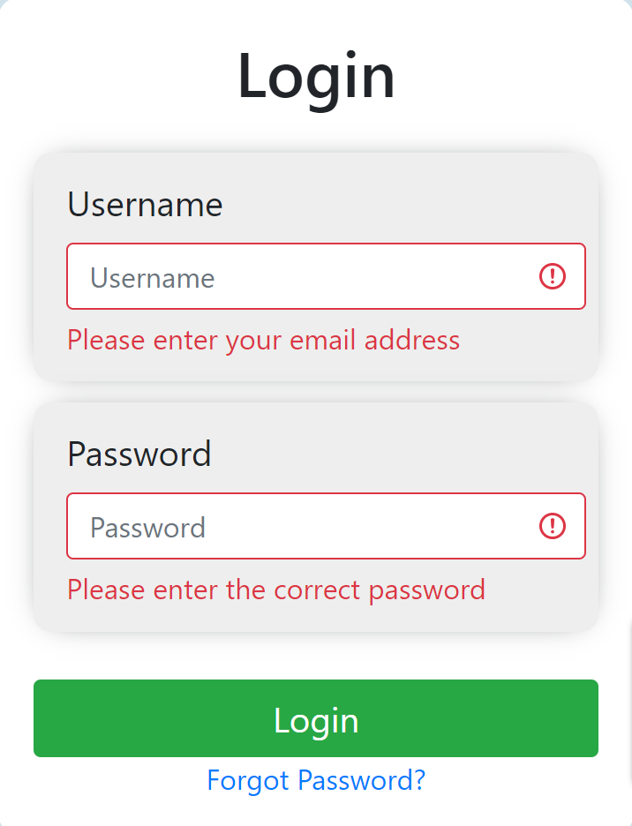
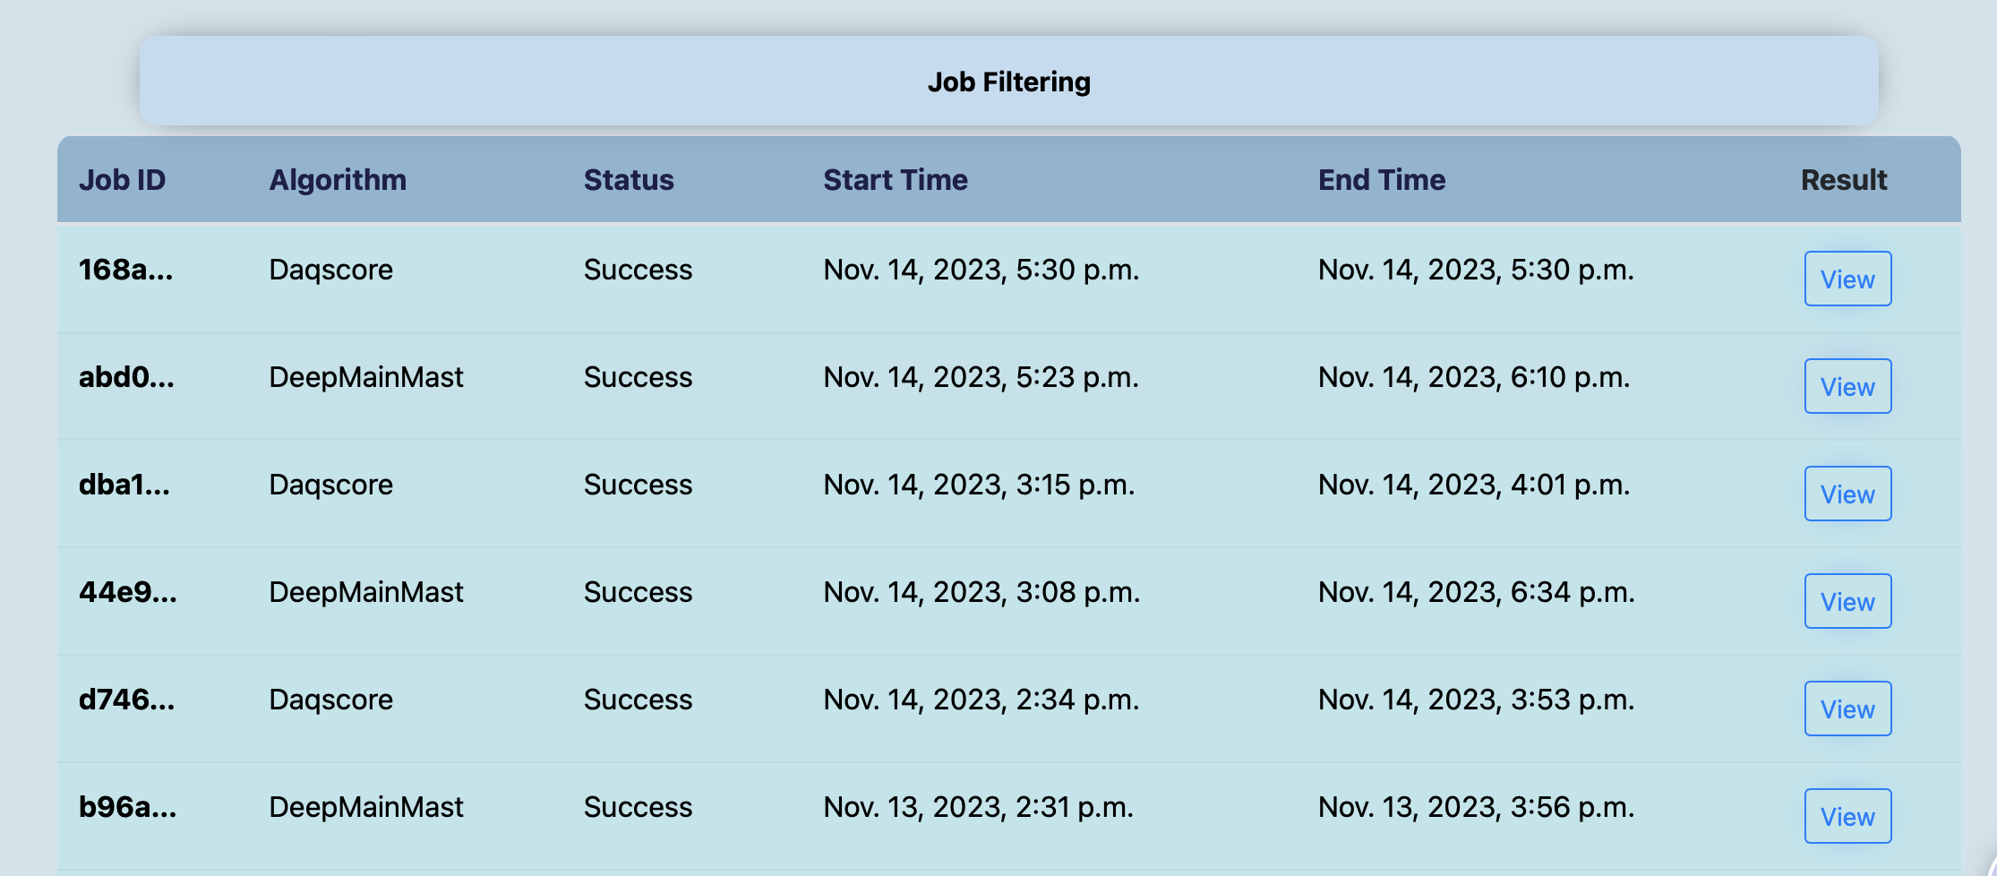
(optional) Registration in Web server https://em.kiharalab.org
https://em.kiharalab.org/users/registerpage
You will need to verify your email address to activate the account. The email will usually arrive instantly, but it might also take up to 1-2 hours.
Job History

Slide 5
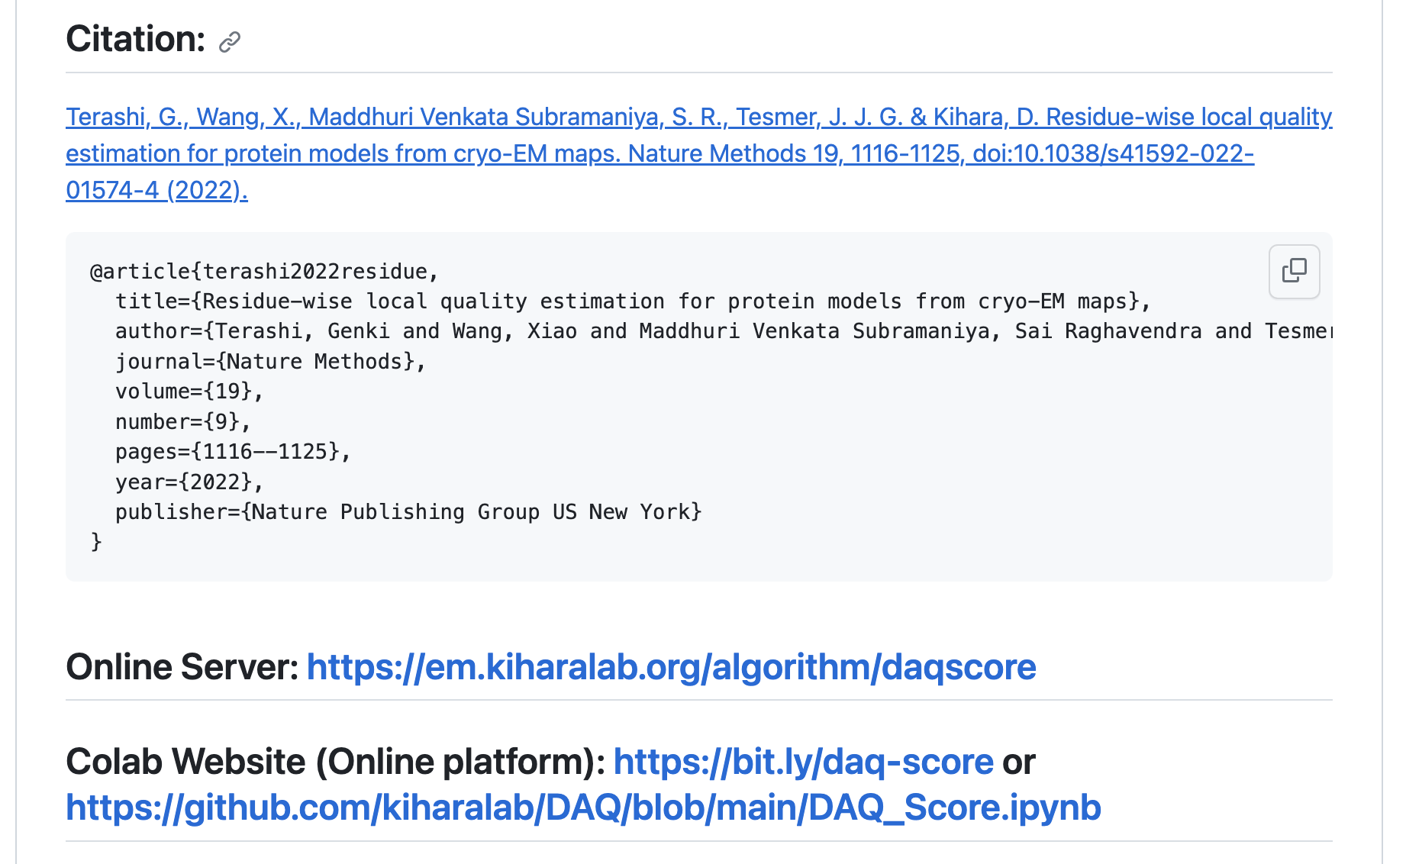
DAQ score on Google Colab https://github.com/kiharalab/DAQ

Slide 6
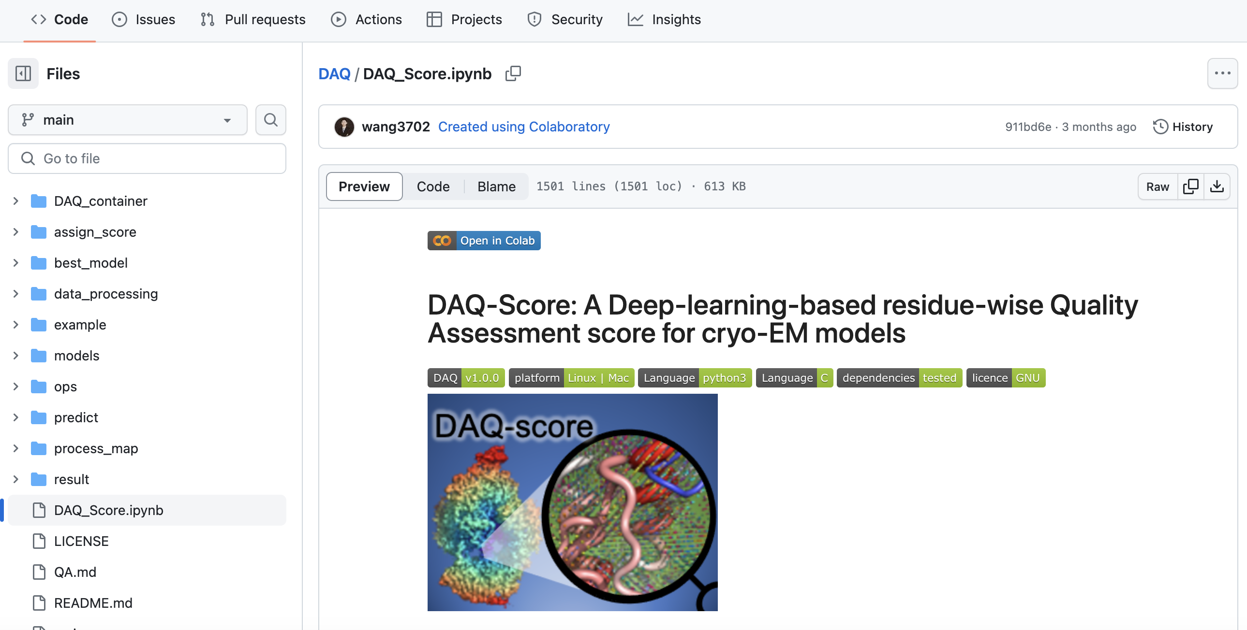
Click [Open in Colab]

Slide 7
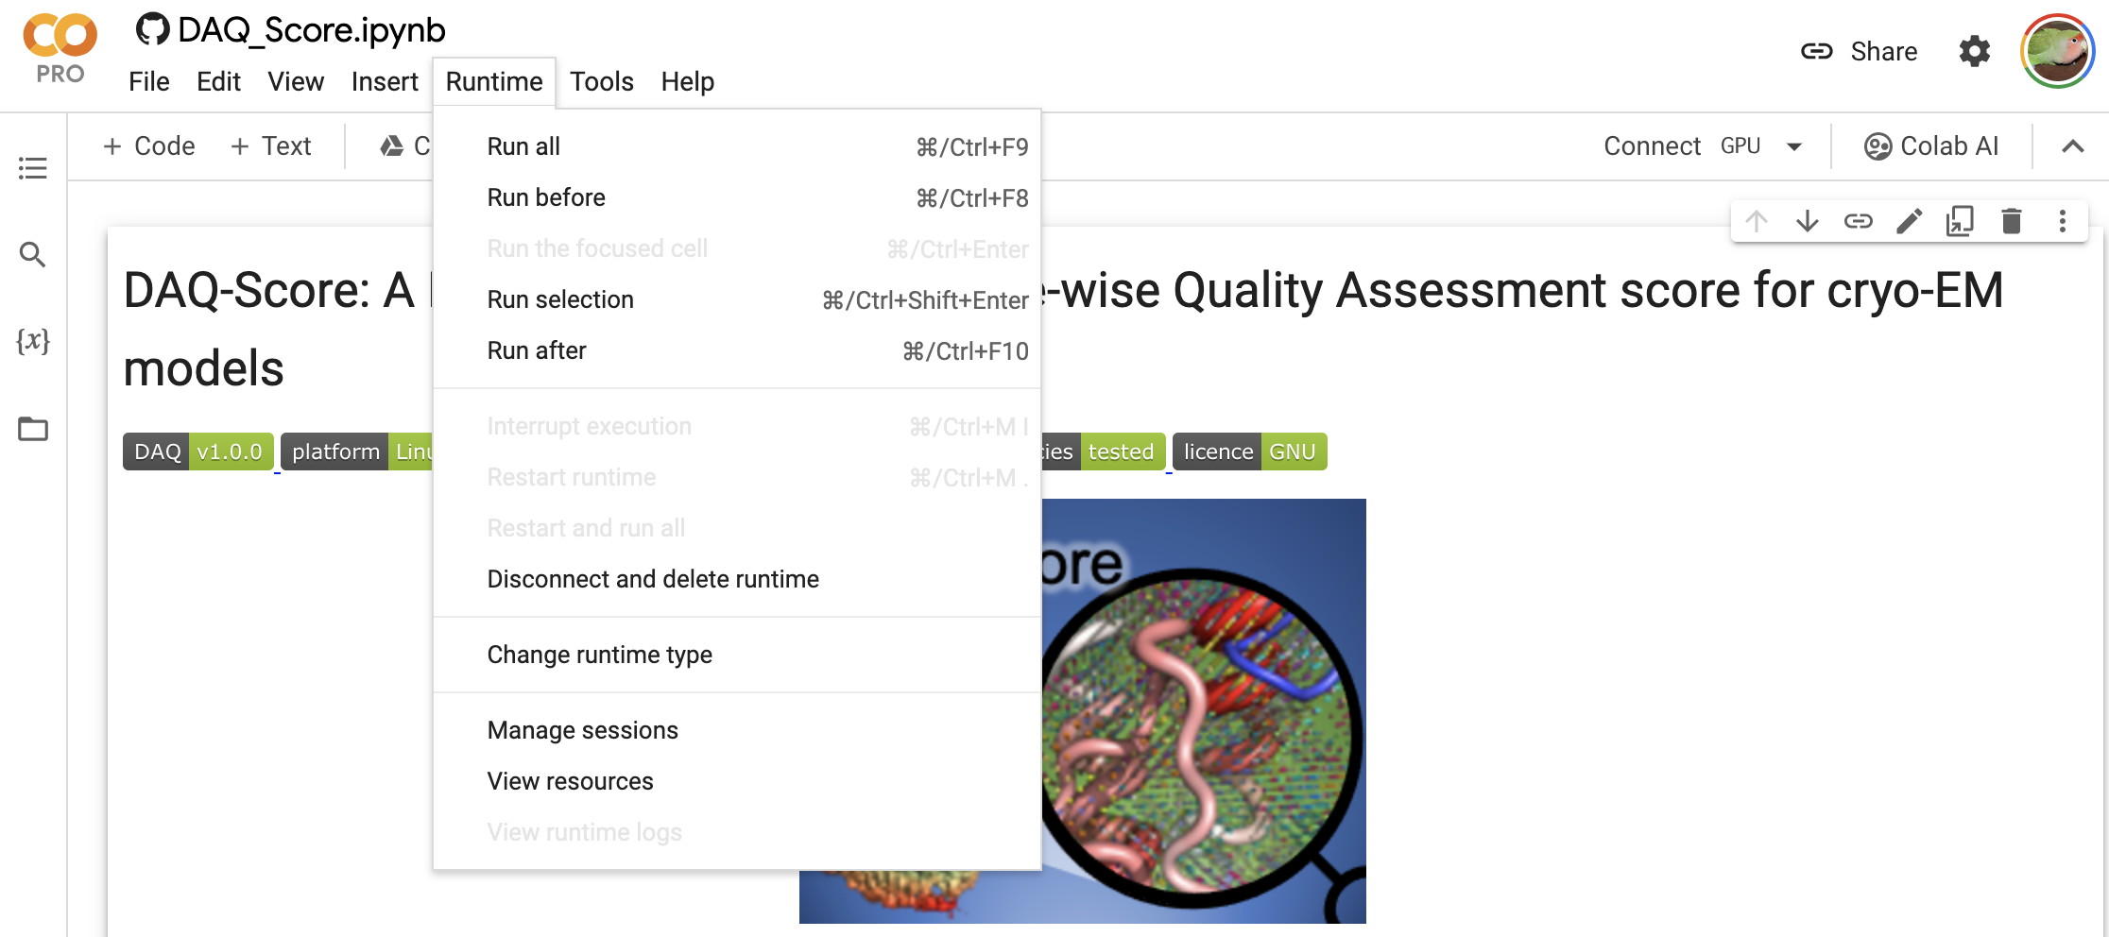
[Runtime]>[Run all]

Slide 8
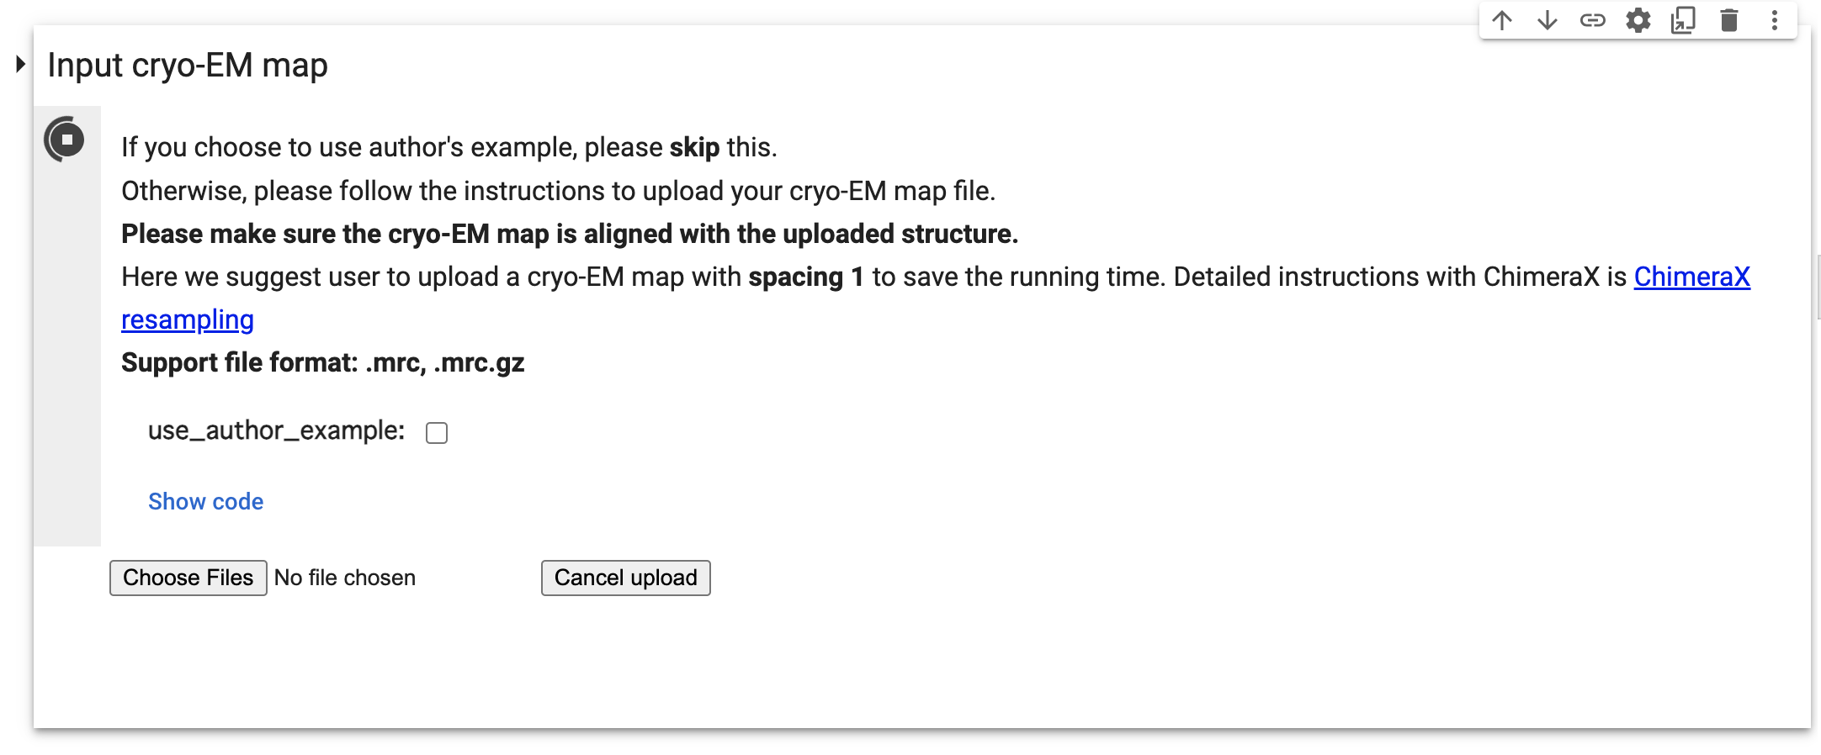
Upload a PDB format file
Upload a Map file

Slide 9
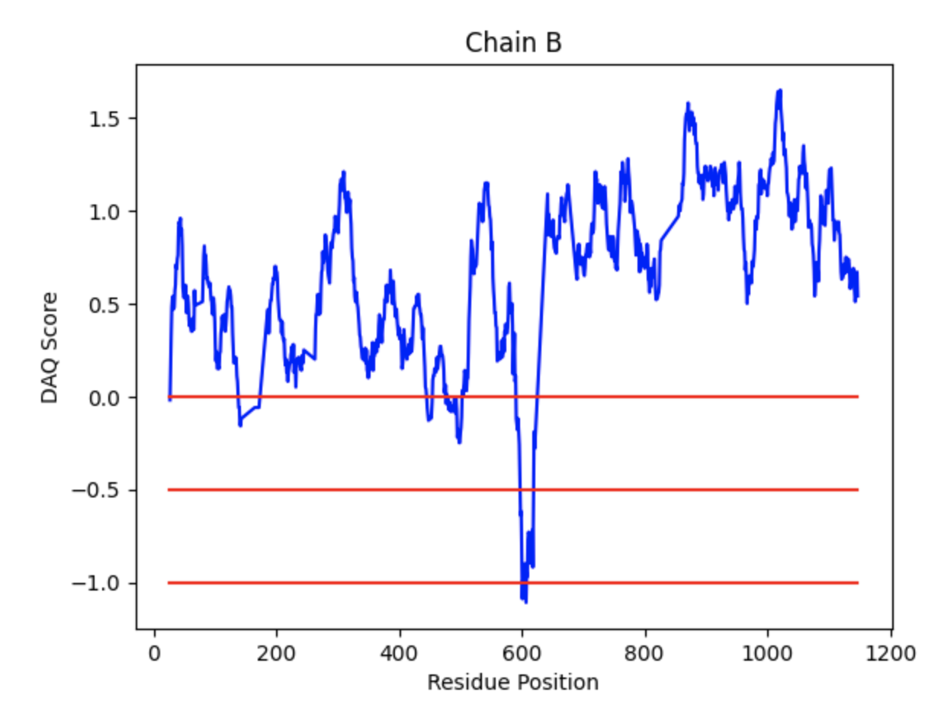
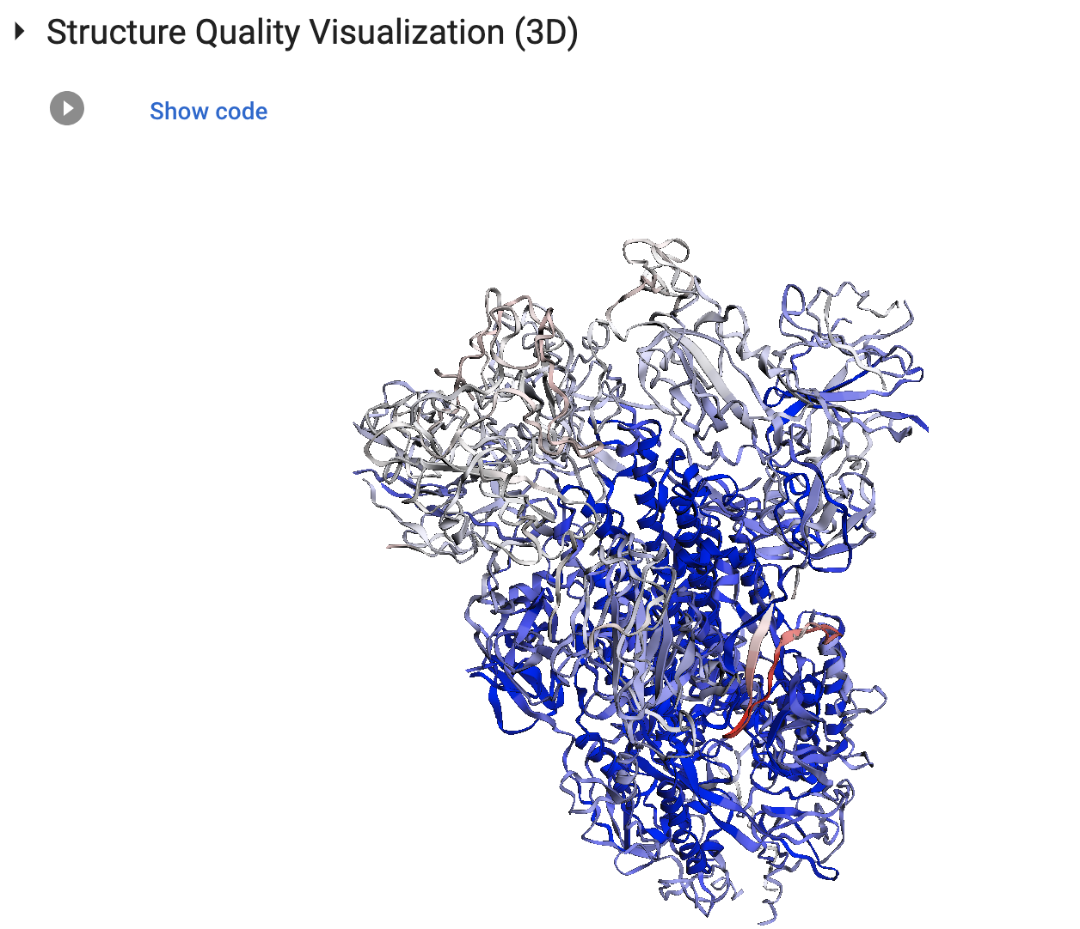
3D mol viewer and DAQ score plots

